Slide 1

QA Documentation. Test Cases. Checklists

Slide 2

How was your self-study?
Requirements (characteristics)?
Types of requirements?
Difference between Business and System requirements?
Questions?

Slide 3
Definition
Test Case – a set of test inputs, execution conditions and expected results developed for a particular objective, such as to exercise a particular program path or to verify compliance with a specific requirements.
Software Testing Checklist – a check list is a catalog of items/tasks that are recorded for tracking. This list could be either ordered in a sequence or could be haphazard.

Slide 4

Types of checklists
Testing Checklist
Exit Criteria Checklist
Test Readiness Review
Automation Checklist

Slide 5
Exit Criteria Checklist Example
Exit Criteria | Status
100% Test Scripts executed | Done
95% pass rate of Test Scripts
No open Critical and High severity defects
95% of Medium severity defects have been closed
All remaining defects are either cancelled or documented as Change Requests for a future release
All expected and actual results are captured and documented with the test script | Done
All test metrics collected based on reports from HP ALM
All defects logged in HP ALM | Done
Test Closure Memo completed and signed off

Slide 6
What tests can we run?
The variety of tests is awesome
Our goal is to decide:
what tests we need
and document them right

Slide 7
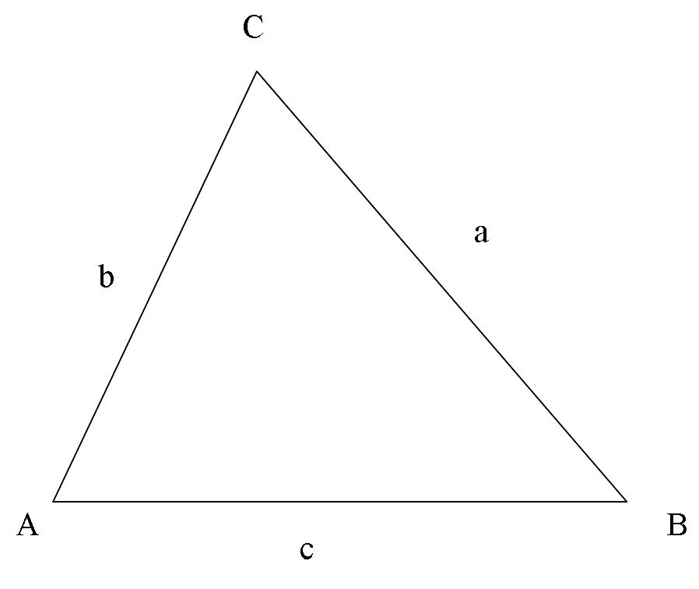
Practice. Trigonometry at test
The program reads three integer values from a card. The three values are interpreted as representing the lengths of the sides of a triangle. The program prints a message that states whether the triangle is scalene, isosceles, or equilateral.
Input: integer a, b, c
Processing: Unknown
Output: a message

Slide 8
Practice. Trigonometry at test
Test case for a valid scalene triangle (a!=b!=c)
Test case for a valid equilateral triangle (a=b=c)
Three test cases for valid isosceles triangles (a=b, b=c, a=c)
Positive tests before negative!
One, two or three sides has zero values (5 cases, not 1)
One side has a negative value
Sum of two sides equals the third (e.g. 1, 2, 3) – it’s not a triangle (test with 3 permutations a+b=c, a+c=b, b+c=a)
Sum of two numbers is less than the third (e.g. 1, 2, 4) – same rule (3 permutations)
Non-integer input
MaxInt value test
Wrong number of values (too many, too few)

Slide 9
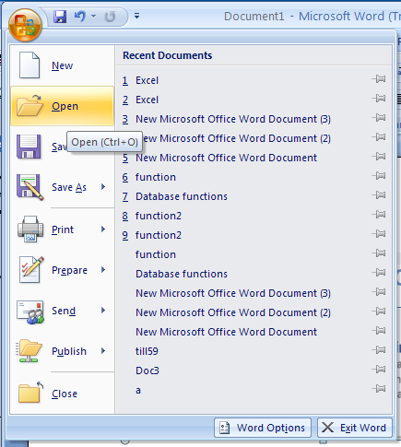
Practice. Test “Open File” function

Slide 10
Practice. Test “Open File” function
Sample of Tests:
Valid file
Locked file
Very big file
Not existing file
File over network
Already opened file
Wrong format file
Empty file
Corrupted file
Cancel operation
Conclusions:
Equivalence classes not evident
Many negative tests
One requirement – lots of tests

Slide 11
Shape a testing mind
Start with obvious and simple tests. Test the program with easy-to-pass values that will be taken as serious issues if the program fails
Look for more powerful tests. Once the program can survive the easy tests, look for challenges
Pick boundary conditions. There will be too many good cases.
Do some exploratory testing
Learn from experience

Slide 12
Why do we need test cases?
A normal thing to ask: Why should we spend time writing our tests down?
We could run so many tests instead!
With test cases we can:
Plan, only then run -> structured and systematic approach -> less bugs missed
Store information
Test the requirements documentation before application is available
Accelerate information to new members of the team
Track testing progress (X% tests executed, Y% tests passed (failed), Z% requirements covered)

Slide 13
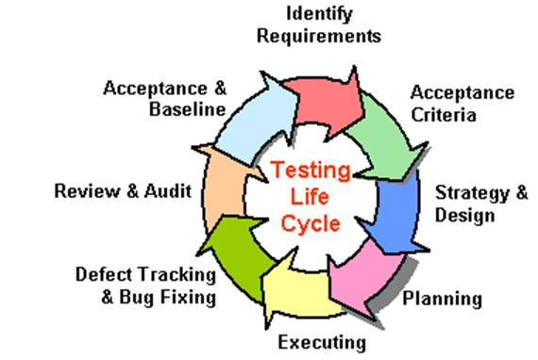
When do we create test cases?

Slide 14
Test case anatomy
We want to document a test. What information should we record?
Test Area
Test Object / Component
Precondition
Steps
Expected results
Status (Passed / Failed / Not Tested / Blocked)
Title
ID
Related requirements
Priority (Smoke, Critical, Extended; or A, B, C, D or any other)
Author, last time run, actual result, related bug
Estimate

Slide 15
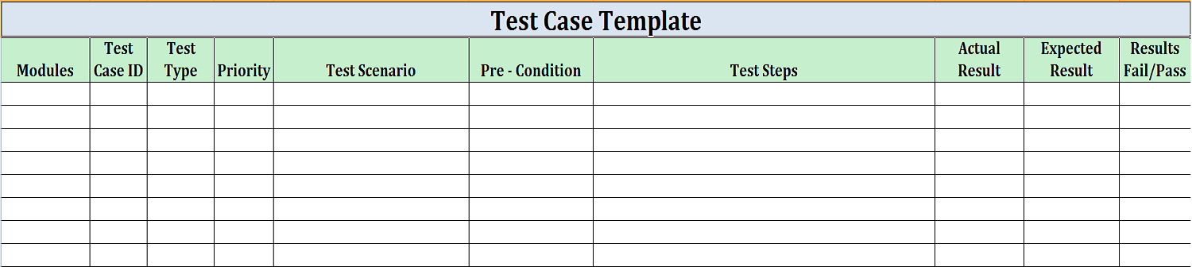
Test case sample

Slide 16
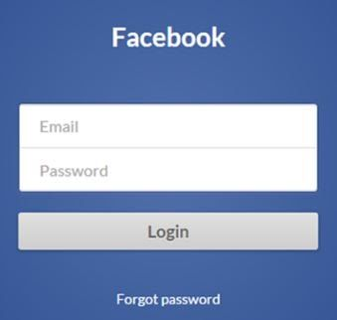
Practice. Write a test case for fb login

Slide 17
Bad Test Case
Has ambiguous steps like “Open file” (except when it’s ok)
Has ambiguous expected result (says “Correctly”)
Depends on other test cases
Duplicate other test cases

Slide 18
Writing Test cases on a large scale
Start early – before the first build
Break application into functions/modules to be tested
Write checklists for each function/area
Add any questions, as you go
Fill in details, resolve questions
Add cosmetics – for better reading
Get review from other QA Engineers, Developers, Customers
Update as soon as mistake is found
Update as functionality changes

Slide 19
Why start early?
We have more time
What sources of information do we have (not) at this time?
Early find is a lower cost
You cannot see working application
Your questions may find and correct serious holes in design
Test cases creation goes in parallel with requirements review
You cannot predict all bugs

Slide 20
How to break it down?
Start with understanding the general picture
Divide the whole product into smaller pieces
Split until you can see no more than 10 (numbers may vary) tests
Some areas may remain complicated – just pay more attention

Slide 21
Review QA Documentation
Get review from other QA Engineers, Team Lead, Business Analyst
Are some interesting tests missed/unnecessary?
Are test cases easy to understand by other person?
Is it what customer expect?
Are there any errors? It’s hard to notice your own mistakes
Developer can have another opinion; we can clarify before the code is created
Raises standard for test cases

Slide 22
Update QA Documentation
Update as soon as mistake is found
Update as functionality changes
Small corrections: do right now, until your forget
Big changes – you can find time for them:
At the beginning new phase
At the end of a build cycle
Sudden free time due to build delay, etc.
Track changes (color code) in order to prioritize tests

Slide 23
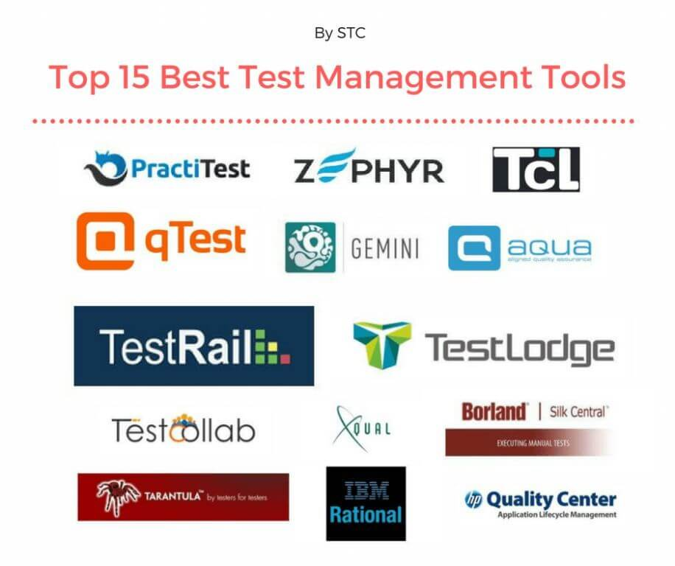
Test Management System and Tools
Professional:
TestRail
TestLink
HP Quality Center
Jira (Zephyr)
IBM Retional
Can be used:
Moztrap
MS Excel
Google Docs

Slide 24
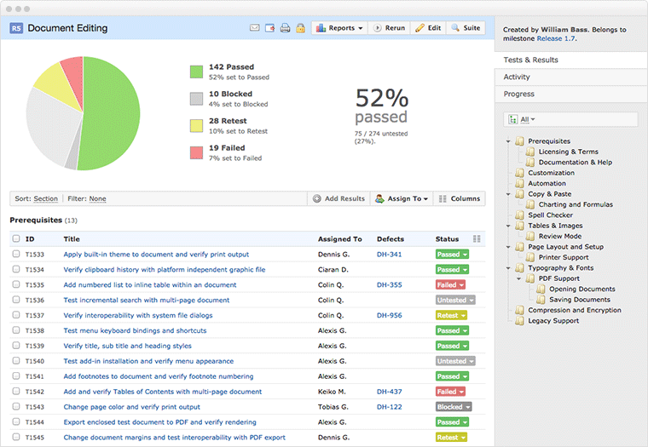
TestRail UI

